Slide 1
Docker
Containerization Platform
Notes:
1

Slide 2
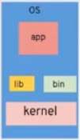
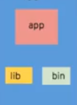

What are Containers?
app
lib
bin
Hypervisor
kernel
kernel
kernel
hardware
hardware
hardware
BARE METAL
HYPERVISOR
Docker
Notes:
Hypervisor
Take resources from physical machine, and emulate and abstract those resources as software and provide them in the form of Virtual Compute, Virtual Storage, Virtual Network etc.
Hypervisor isolates and protect each from VM from consuming virtual machines resources
2

Slide 3
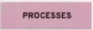

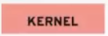
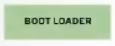


Virtual Machine v/s Docker
App
App
App
HYPERVISOR
KERNEL
hardware
hardware
Notes:
3

Slide 4
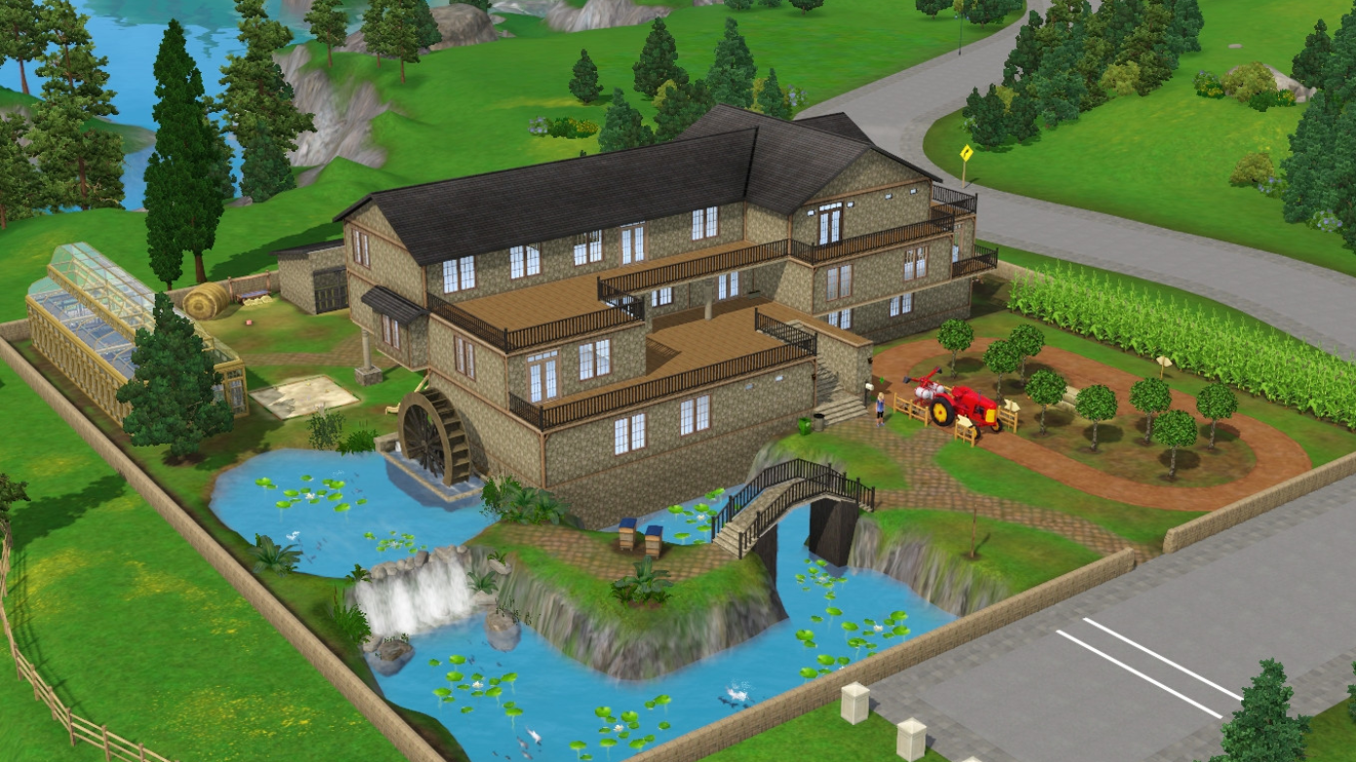
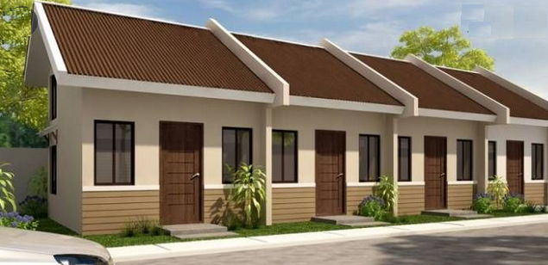
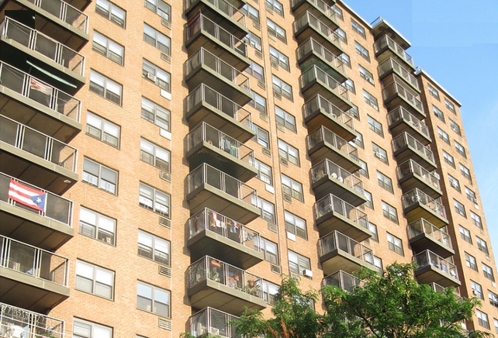
Bare Metal / VMs / Containers
INDEPENDANT HOUSES
ROW HOUSES
APARTMENTS
Notes:
4

Slide 5
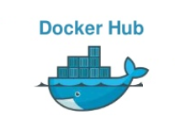
Docker in Action
Notes:
Cloud repository to create, test and distribute docker images.
5

Slide 6
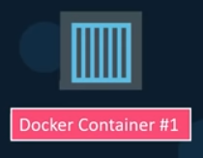
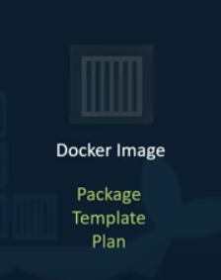
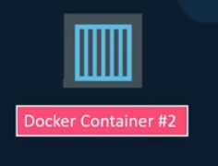
Docker in Action
Notes:
Cloud repository to create, test and distribute docker images.
6

Slide 7

What happens under the hood ?
Processes
Network
Mounts
Processes
Network
Mounts
Processes
Network
Mounts
Processes
Network
Mounts
Docker
OS Kernel
Notes:
7

Slide 8





Sharing the Kernel?
Software
Software
Software
Software
OS Kernel
Notes:
8

Slide 9
Namespaces
MNT file system
NET network
UTS hostname
PID process
USER user
IPC inter process communication
Notes:
9

Slide 10
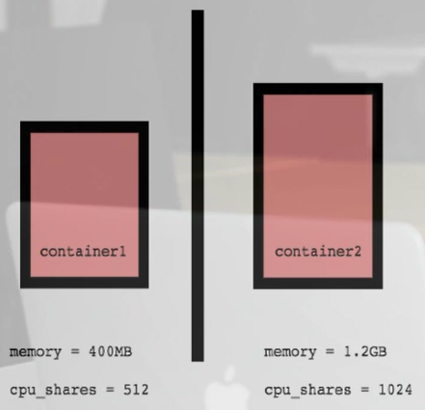
Control Groups
Resource metering and limiting
Memory
CPU
Block IO
Network
Notes:
10

Slide 11

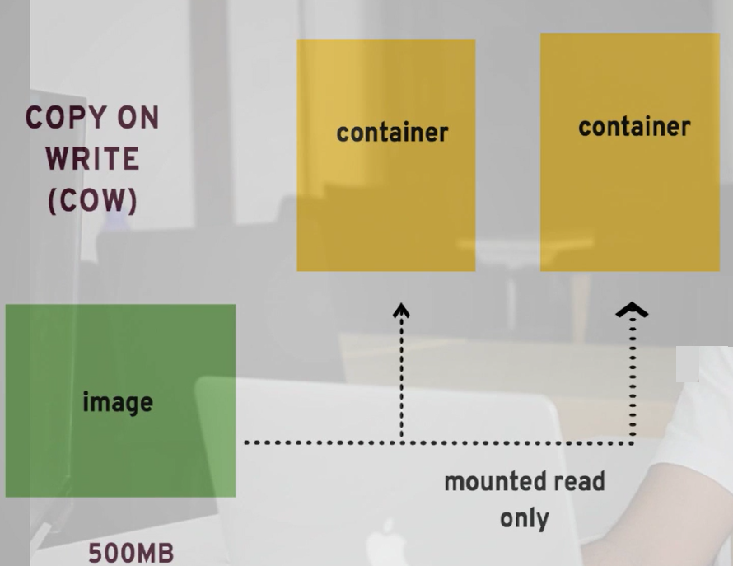
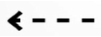
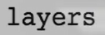
Filesystem
Notes:
11

Slide 12
Docker container in a nutshell
own process space
own network interface
can run applications as root
can install packages
can run services
can modify routing, iptables
Notes:
12

Slide 13

Docker Architecture
Notes:
Docker Daemon
A persistent background process that manages Docker images, containers, networks, and storage volumes. The Docker daemon constantly listens for Docker API requests and processes them.
Docker Engine REST API
API used by applications to interact with the Docker daemon
Docker CLI
A command line interface client for interacting with the Docker daemon.
13

Slide 14
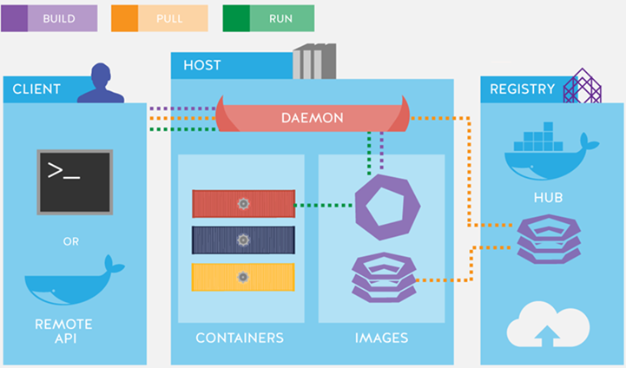
Docker Architecture
Notes:
14

Slide 15
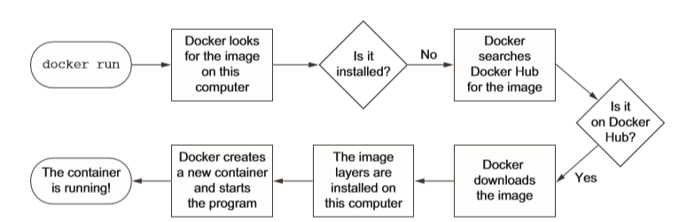
Running your first container
Notes:
NAMESPACES is to limit what you see and identify system resources. Restrict what a process can or can’t see.
ls –l /proc/id/ns
15

Slide 16
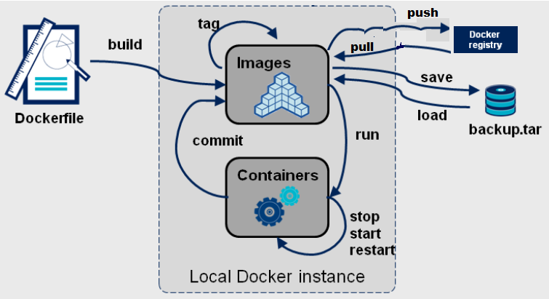
Docker Container Lifecycle
Notes:
Cloud repository to create, test and distribute docker images.
16

Slide 17

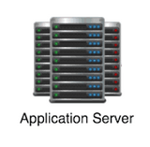
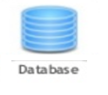

Problem statement
Webserver
Application Server
Database
Caching
Compatibility & Dependency
Libraries
Dependencies
Long setup time
OS
Dev/Test/Prod environment
Hardware Infrastructure
Notes:
17

Slide 18
Containers
Webserver
Application Server
Database
Caching
Libs
Deps
Libs
Deps
Libs
Deps
Libs
Deps
Docker
OS
Hardware Infrastructure
Notes:
18

Slide 19
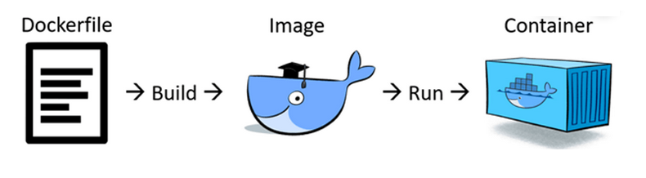
Dockerfile
Notes:
docker image history testimage
19

Slide 20
Writing your first Dockerfile
FROM
RUN
CMD
ENTRYPOINT
ENV
COPY
ADD
WORKDIR
EXPOSE
ARGS
USER
Notes:
docker image history testimage
20

Slide 21
FROM
Valid docker file should start with FROM
Multiple times.
Different forms
- FROM: tag/digest
- FROM ubuntu:latest AS abc
Notes:
docker image history testimage
21

Slide 22
Execution RUN/ CMD/ ENTRYPOINT
RUN
Build time instruction
often used for installing software packages
Creates new layer and creates a new image
CMD
Runtime instruction
Execute the instruction during the container at launch time
One per dockerfile
Command line parameter pass will get replaced.
ENTRYPOINT
Runtime instruction
Allows you to configure a container that will run as an executable.
Command line command line get appended.
Notes:
docker image history testimage
22

Slide 23
Execution RUN/ CMD/ ENTRYPOINT
Exp:
FROM ubuntu:latest
RUN apt-get update
RUN apt-get install -y iputils-ping
CMD ping localhost
Exp:
FROM ubuntu
RUN apt-get update
ENTRYPOINT ["/bin/echo", "Hello World"]
Notes:
docker image history testimage
23

Slide 24
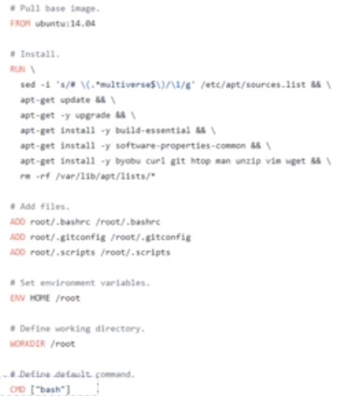
CMD example
Notes:
24

Slide 25
Dockerfile Reference
ENV
Set environment variables
FROM ubuntu
ENV HOME /root
CMD echo ${HOME}
EXPOSE
Inform the network port the container listens on runtime
RUN apt-get install apache2 -y
RUN apt-get install apache2-utils -y
…
EXPOSE 80
ENTRYPOINT ["apache2ctl"]
CMD ["-DFOREGROUND"]
Notes:
25

Slide 26
Dockerfile Reference
WORKDIR
Sets the working directory for any RUN, CMD, ENTRYPOINT, COPY and ADD instructions that follow
WORKDIR /usr/src/app
COPY package.json /usr/app/python/
USER
Sets the user name or UID to use when running the image and for any RUN, CMD and ENTRYPOINT instructions that follow it
Notes:
26

Slide 27
Dockerfile COPY vs ADD
COPY
Copy one or more file/directory from host to destination
Copied at build time
FROM ubuntu
ENV HOME /root
CMD echo ${HOME}
ADD
In addition to COPY command, it also support copy from a URL.
Copied at build time
ADD http://example.com/big.tar.xz /usr/src/things/
RUN tar -xJf /usr/src/things/big.tar.xz -C /usr/src/things
RUN make -C /usr/src/things all
Notes:
27

Slide 28
HEALTH CHECK
Check container health by running a command inside the container
FROM nginx:latest
HEALTHCHECK --interval=5s --timeout=3s CMD curl --fail http://localhost:80/hello.html || exit 1
EXPOSE 80
Notes:
28

Slide 29
Designing and Architecting Containers
Reducing the image size
Package a single app per container
Optimize for the Docker build cache
Remove unnecessary tools
Use vulnerability scanning in Container Registry
Avoid privileged containers; Avoid running as root
Carefully choose the image version
Notes:
29

Slide 30
Resource Provisioning
docker container run -d --memory-reservation=750m
docker container run -d --memory=20m --memory-swap=20m
docker container run -d –cpus=2
docker container run -d --cpu-shares=100
docker container run -d --pids-limit=100
Notes:
30

Slide 31
Container Statistics
docker stats <containerid>
docker top <containerid>
docker logs <containerid>
Notes:
31

Slide 32
Docker use cases
Simplifying Configuration
Code Pipeline Management
Developer Productivity
Application Isolation
Multitenant applications
Notes:
32

Slide 33
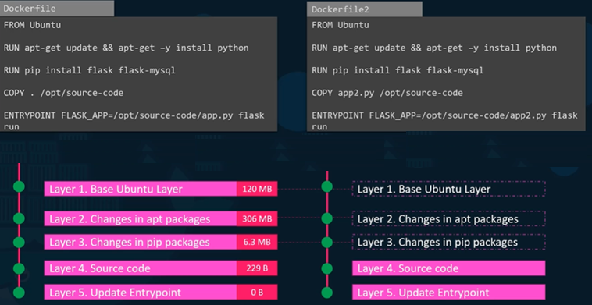
Docker Layered Architecture
Notes:
33

Slide 34
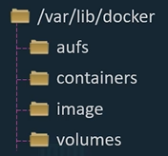
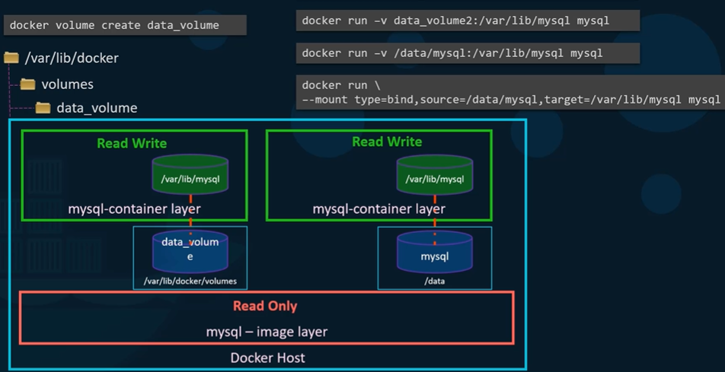
Docker Volumes
Volume mounting
- docker default volume location
/var/lib/docker/volumes
Bind mounting
- Any location in the host
Notes:
34

Slide 35
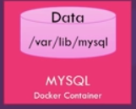
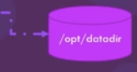
Docker Volume
How data is persisted ?
Running MySQL database
docker run –v /opt/datadir:/var/lib/mysql mysql
Notes:
35

Slide 36
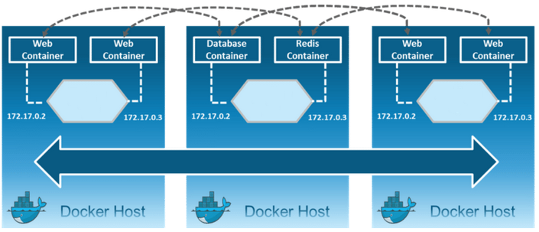
Docker Networking
Notes:
36

Slide 37
Default Bridge
Default Docker Bridge
eth0
IP Tables
docker0
C1
C2
Notes:
37

Slide 38
Network Drivers
Bridge
None
Overlay
host
Macvlan
Notes:
38

Slide 39
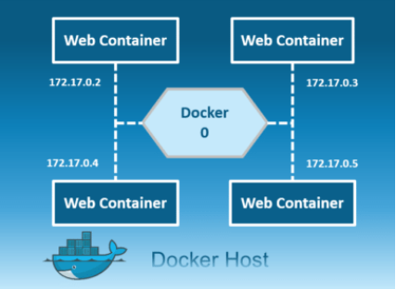
Docker Bridge Network
Private network restricted to single host
All containers inside this bridge can communicate each other
Each containers are placed in its own network namespace
Notes:
39

Slide 40
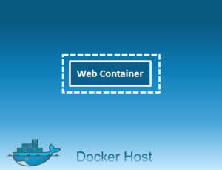
None
$ docker network create -d none my-none-net
Uses the host’s networking directly to communicate between containers and to the host
Notes:
40

Slide 41
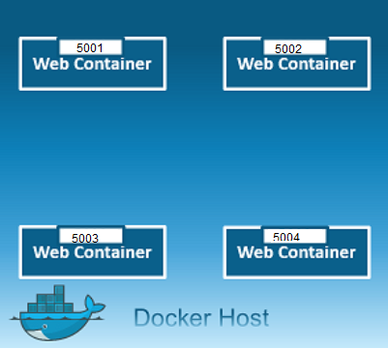
Host Network
$ docker network create -d host my-host-net
Uses the host’s networking directly to communicate between containers and to the host
Notes:
41

Slide 42
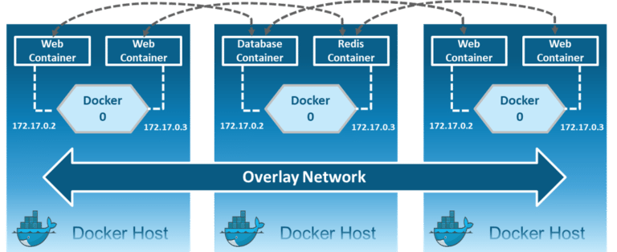
Overlay
Overlay network driver is used for multi-host network communication.
$ docker network create -d overlay
--subnet=192.168.10.0/24 my-overlay-net
Notes:
42

Slide 43
Docker Best Practices
Prefer minimal base images
Package a single application per container
Optimize for the Docker build cache
Remove unnecessary tools
Build the smallest image possible
Properly tag your images
Notes:
43

